Slide 1
Week 4: Network Protocols and Communications
Notes:
Cisco Networking Academy Program
Introduction to Networks v6.0
Chapter 3: Network Protocols and Communications

Slide 2
Aims & Objectives
3.1 Rules of Communication
Describe the types of rules that are necessary to successfully communicate.
3.2 Network Protocols and Standards
Explain why protocols are necessary in communication.
Explain the purpose of adhering to a protocol suite.
Explain the role of standards organizations in establishing protocols for network interoperability.
Explain how the TCP/IP model and the OSI model are used to facilitate standardization in the communication process.
3.3 Data Transfer in the Network
Explain how data encapsulation allows data to be transported across the network.
Explain how local hosts access local resources on a network.
Notes:
2

Slide 3
3.1 Rules of Communication
Notes:
Cisco Networking Academy Program
Introduction to Networks v6.0
Chapter 3: Network Protocols and Communications

Slide 4
Standardized Protocol Architectures
Required for devices to communicate
Vendors have more marketable products
Customers can insist on standards based equipment
Two standards:
OSI Reference model
Never lived up to early promises
TCP/IP protocol suite
Most widely used
Also: IBM Systems Network Architecture (SNA)

Slide 5
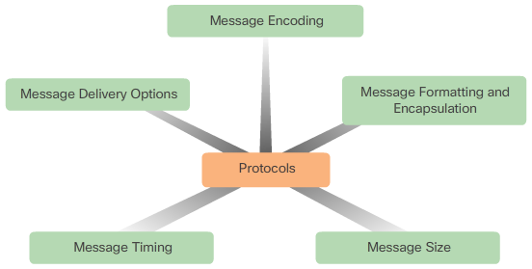
Rules of Communication The Rules
Rule Establishment
Identified sender and receiver
Common language and grammar
Speed and timing of delivery
Confirmation or acknowledgment requirements
Message Encoding
Process of converting information into another acceptable form
Message Formatting and Encapsulation
Message Size
Message Timing
Access method
Flow control
Response timeout
Message Delivery Options
Unicast
Multicast
Broadcast
Notes:
3.1 – Rules of Communication
3.1.1 – The Rules

Slide 6
3.2 Network Protocols and Standards
Notes:
Cisco Networking Academy Program
Introduction to Networks v6.0
Chapter 3: Network Protocols and Communications

Slide 7
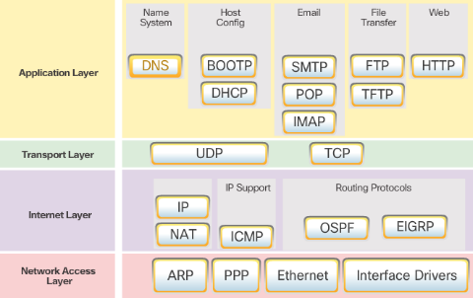
Network Protocols and Standards Protocol Suites
Protocol Suites and Industry Standards
TCP/IP is an open standard
Can you name other protocol suites?
TCP/IP Protocol Suites
Can you name some of the protocols from the TCP/IP protocol suite.
TCP/IP Communication Process
Can you describe the process?
Notes:
3.2 – Network Protocols and Standards
3.2.2 – Protocol Suites

Slide 8
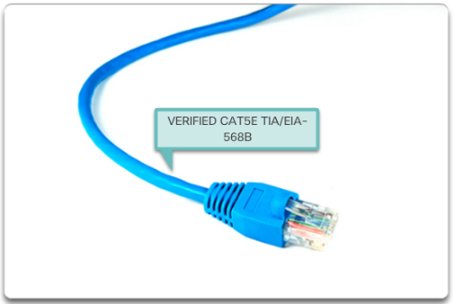
Network Protocols and Standards Standard Organizations
Open Standards
Name some advantages of open standards
Internet Standards
Name a few standard organizations
Electronics and Communications Standards Organizations
Name a few organizations
Notes:
3.2 – Network Protocols and Standards
3.2.3 – Standard Organizations

Slide 9
OSI
Open Systems Interconnection
Developed by the International Organization for Standardization (ISO)
Seven layers
A theoretical system delivered too late!
TCP/IP is the de facto standard

Slide 10
OSI - The Model
A layer model
Each layer performs a subset of the required communication functions
Each layer relies on the next lower layer to perform more primitive functions
Each layer provides services to the next higher layer
Changes in one layer should not require changes in other layers

Slide 11
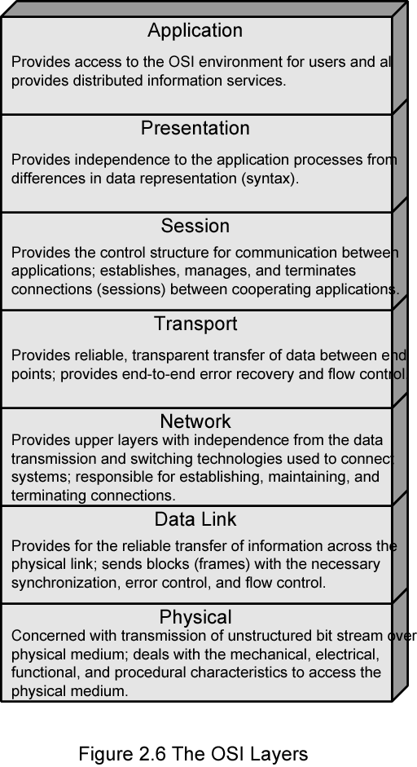
OSI Layers

Slide 12
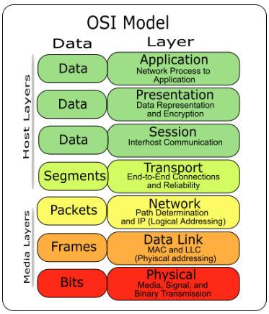
OSI Model

Slide 13
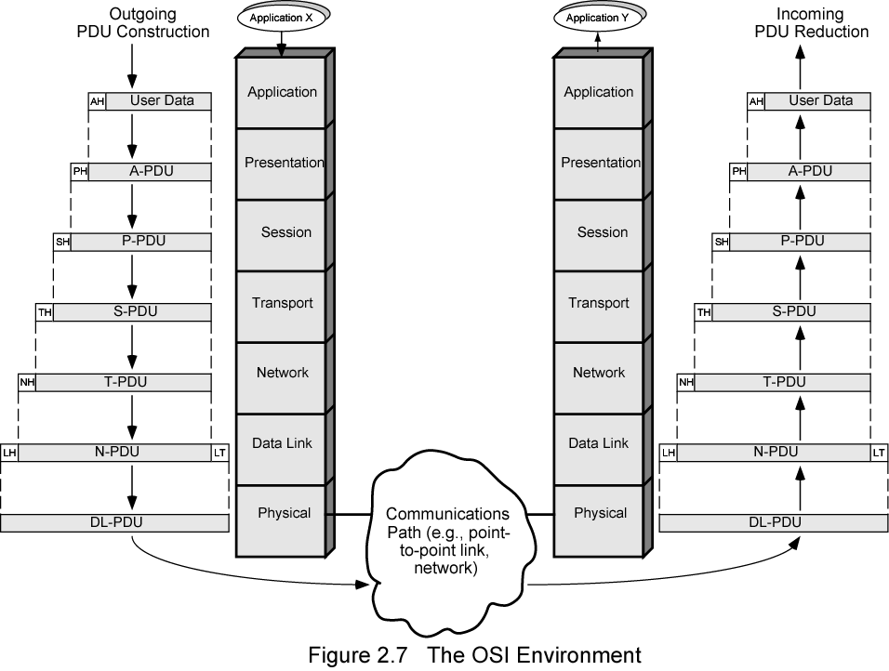
The OSI Environment

Slide 14
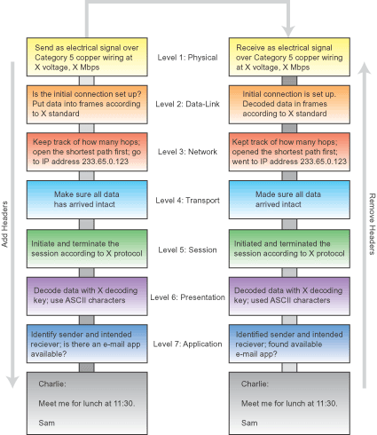

Slide 15
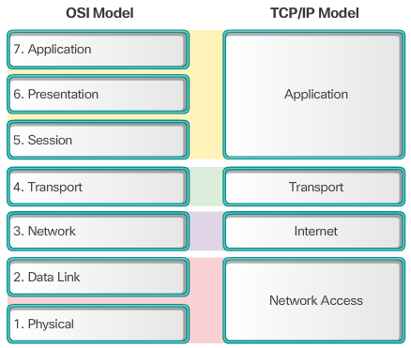
Network Protocols and Standards Reference Models
The Benefits of Using a Layered Model
Name some benefits
The OSI Reference Model
Provides list of functions
Describes interactions between layers
OSI Model and TCP/IP Model Comparison
Similar: transport and network layers
Contrast: relationship between layers
Notes:
3.2 – Network Protocols and Standards
3.2.4 – Reference Models

Slide 16
3.3 Data Transfer in the Network
Notes:
Cisco Networking Academy Program
Introduction to Networks v6.0
Chapter 3: Network Protocols and Communications

Slide 17
OSI Layers (1)
Physical
Physical interface between devices
Mechanical
Electrical
Functional
Procedural
Data Link
Notes:
Means of activating, maintaining and deactivating a reliable link
Error detection and control
Higher layers may assume error free transmission

Slide 18
OSI Layers (2)
Network
Higher layers do not need to know about underlying technology
Transport
Notes:
Not needed on direct links
Transpot Layer
Exchange of data between end systems
Error free
In sequence
No losses
No duplicates
Quality of service
Process level addressing
Flow control

Slide 19
OSI Layers (3)
Session
Control of dialogues between applications
Dialogue discipline
Recovery
Presentation
Application
Means for applications to access OSI environment
Notes:
Data formats and coding
Data compression
Encryption

Slide 20
TCP/IP Protocol Architecture
Developed by the US Defense Advanced Research Project Agency (DARPA) for its packet switched network (ARPANET)
Used by the global Internet
No official model but a working one.
Notes:
Application layer
Host to host or transport layer
Internet layer
Network access layer
Physical layer

Slide 21
Physical Layer
Physical interface between data transmission device (e.g. computer) and transmission medium or network
Characteristics of transmission medium
Signal levels
Data rates
etc.

Slide 22
Network Access Layer
Exchange of data between end system and network
Destination address provision
Invoking services like priority

Slide 23
Internet Layer (IP)
Systems may be attached to different networks
Routing functions across multiple networks
Implemented in end systems and routers

Slide 24
Transport Layer (TCP)
Reliable delivery of data
Ordering of delivery

Slide 25
Application Layer
Support for user applications
e.g. http, SMPT

Slide 26
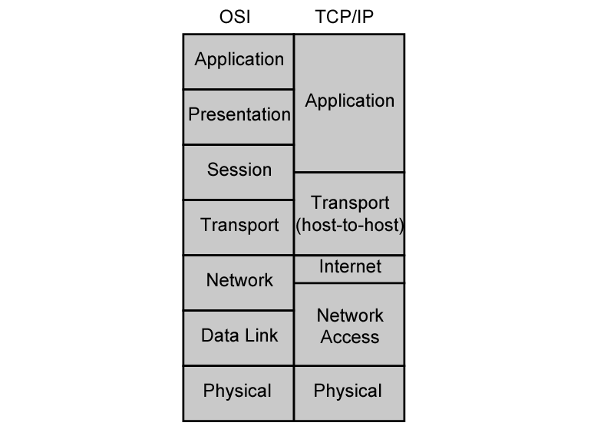
OSI v TCP/IP

Slide 27
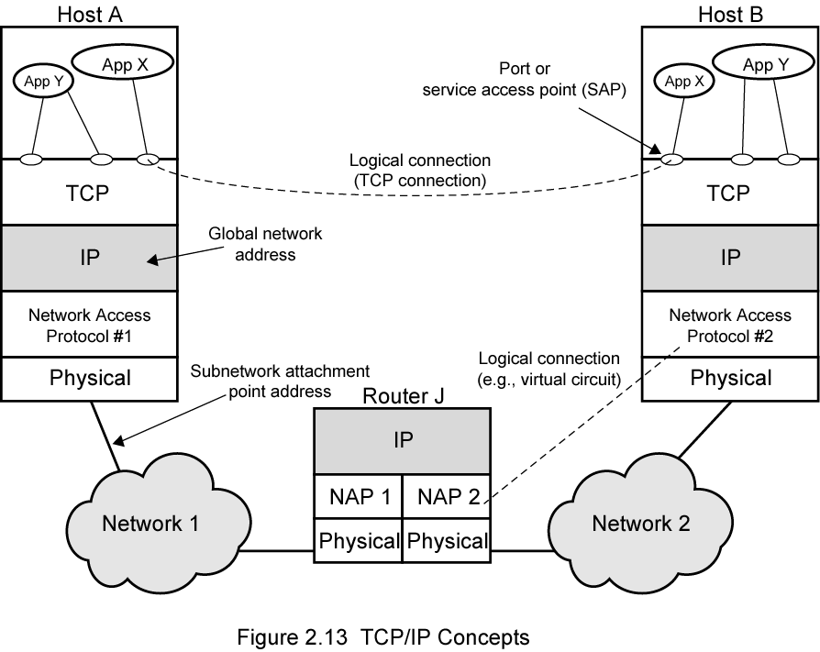
TCP/IP Concepts

Slide 28
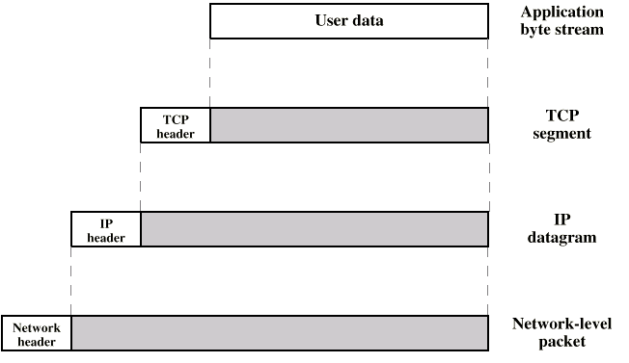
PDUs in TCP/IP

Slide 29
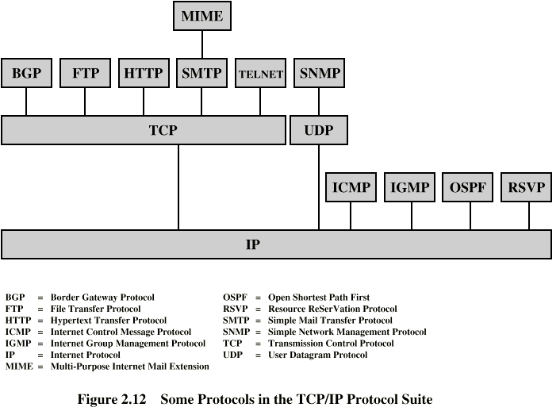
Some Protocols in TCP/IP Suite

Slide 30
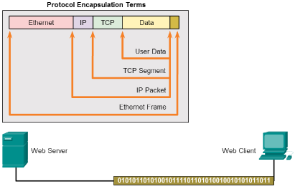
Data Transfer in the Network Data Encapsulation
Message Segmentation
Segmentation - Break communication into pieces
Multiplexing – interleaving the pieces
Protocol Data Units
What are PDUs called at each layer?
Encapsulation and de-encapsulation process
Notes:
3.3 – Data Transfer in the Network
3.3.1 – Data Encapsulation

Slide 31
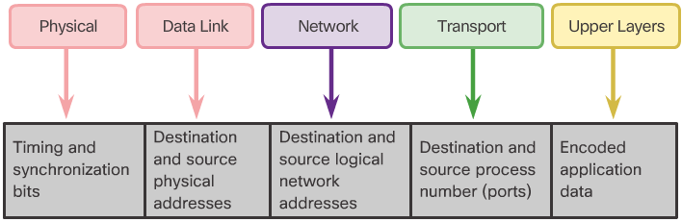
Data Transfer in the Network Data Access
Network Addresses
Source IP address
Destination IP address
Deliver the IP packet from the original source to the final destination, either on the same network or to a remote network.
Data Link Addresses
Source data link address
Destination data link address
Deliver the data link frame from one network interface card (NIC) to another NIC on the same network
Devices on the Same Network
Devices on a Remote Network
Notes:
3.3 – Data Transfer in the Network
3.3.2 – Data Access

Slide 32
Addressing Requirements
Two levels of addressing required
Each computer needs unique network address(IP & MAC)
Each application on a (multi-tasking) computer needs a unique address within the computer
The service access point or SAP
The port on TCP/IP stacks

Slide 33
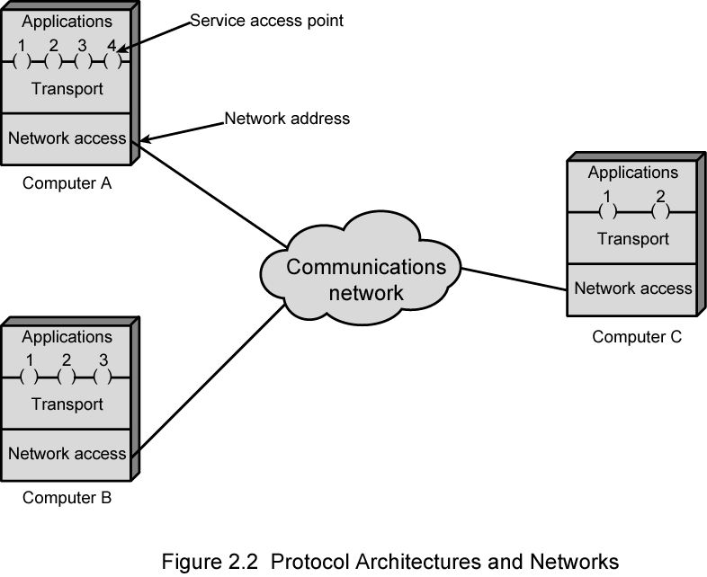
Protocol Architectures and Networks

Slide 34
ARP

Slide 35
Questions

